Slide 1
Shinobi
John Byrd
Sega of America
Confidential
Notes:
Your notes here.

Slide 2
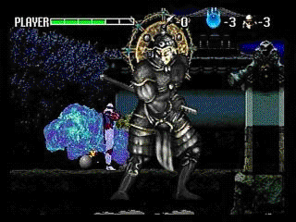
Shinobi overview
Memory management
Peripherals
File system
Timers
Confidential
Notes:
Your notes here.

Slide 3

Memory management
Sections
The linker
Generating a
.MAP file
Functions
sbinit.c

Slide 4
Sections 1
Memory regions, sorted by the linker
  Sizes and locations are determined at link time

Slide 5
Sections 2
Always mapped in this order:
  Prequel code
  Your code and constants
  Sega’s libraries and constants
  Uninitialized data space
  (Implied) heap space

Slide 6
Prequel code section types
DSGLx: Code entry points
IP: Sega security stuff

Slide 7
Your code and constant section types
P: your program
C, C32: your constants
D, D32: your pre-sized data
R, R32: your startup code

Slide 8
Sega’s libraries and constants
PSGxx: Sega code
CSGxx: Sega library constants
DSGxx, RSGxx: Sega library data

Slide 9
Uninitialized data space
B, BSG, BSG32
  After BSG32 lives the heap, which is currently set up within sbinit.c

Slide 10
Choosing the section manually in your code
#pragma section name
/* this is the code that want to send to that section */
#pragma section

Slide 11
The linker
lnk.exe
Link order is important within a section only
Currently strips dead code at the .obj file level (not the function level)

Slide 12
Exercise
Generate a .MAP file to investigate the memory layout within the kmblend example.

Slide 13
Functions
Void syMallocInit(Void *heap, Uint32 size);
Void syMallocFinish(Void);
#define syMalloc(__nbytes__) malloc(__nbytes__)
#define syFree(__ap__) free(__ap__)

Slide 14
Aligning to 32 bytes
#define Align32Byte(ADR) (((long) ADR) + ((32 - (((long) ADR) & 0x1F)) & 0x1F))
But don’t forget to allocate up to 32 bytes of fudge

Slide 15
sbinit.c
Sets up the system’s heap for syMalloc()
Uses Ninja or Kamui for graphics
Leaving USE_GDFS on will hang if GD Workshop is not running

Slide 16
Peripherals
sbinit.c calls pdInitPeripheral() for you
Query the peripheral near the vertical blank
Get the data from the peripheral

Slide 17
Query the peripheral on the vertical blank
  kmFlipFrameBuffer();
  /* must call this straight after flip frame buffer */
  pdExecPeripheralServer();

Slide 18
Get the data from the peripheral
  const PDS_PERIPHERALINFO* info;
  const PDS_PERIPHERAL* per;
  per = pdGetPeripheral(PDD_PORT_A0);

Slide 19
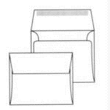
File system
Opening and closing a file
Reading a file
  Synchronously
  Asynchronously
Changing the file position

Slide 20
Initialize the filesystem first
gdFsInit(Sint32 max_open, void *gdfs_work, Sint32 max_dirent, void *gdfs_dirrec)
Notes:
gdFsInit(Sint32 max_open, void *gdfs_work, Sint32 max_dirent, void *gdfs_dirrec)
This function only needs to be called to determine the number of files that need to be open at one time, as well as buffers for the current directory.
GDFS gdFsOpen(const char *fname, GDFS_DIRREC gf_dirrec);
GDFS gdFsOpen(const char *fname, GDFS_DIRREC gf_dirrec);
gf_dirrec is a handle to a directory; these are accessible via gdFsCreateDirhn() and gsFsLoadDir().
void gdFsClose(GDFS gdfs);

Slide 21
Opening and closing a file
  GDFS gdFsOpen(const char *fname, GDFS_DIRREC gf_dirrec);
  void gdFsClose(GDFS gdfs);

Slide 22
Reading a file synchronously
Open the file with gdFsOpen, then…
Determine the number of sectors to read
Do the read
Close the file as soon as convenient

Slide 23
Determine the number of sectors to read
A sector is 2048 bytes
Align the read if it’s a texture
  Bool gdFsGetFileSctSize(GDFS gdfs, Sint32 *fsctsize);

Slide 24
Do the read
Sint32 gdFsRead(GDFS gdfs, Sint32 nsct, void *buf);

Slide 25
Close the file as soon as convenient
void gdFsClose(GDFS gdfs);

Slide 26
Example: geotest.c in kmsample
/* open file */
gdfs = gdFsOpen(filename, dirrec);
if (gdfs == NULL) return -1; /* File Open Error */
gdFsGetFileSize(gdfs, &size); /* get file size */
size = gdFsCalcSctSize(size); /* calc sctor size */
ret = gdFsRead(gdfs, size, (void *)TextureReadBuffer); /* read file */
gdFsClose(gdfs); /* close file */
if (ret != GDD_ERR_OK) return -2; /* file read error */

Slide 27
Reading a file asynchronously
Determine the file’s sector size before issuing the read
Do the actual read
Wait until the read is completed

Slide 28
Determine the file’s sector size
Bool gdFsGetFileSctSize(GDFS gdfs, Sint32 *fsctsize);

Slide 29

Do the actual read
Sint32 gdFsReqRd32(GDFS gdfs, Sint32 nsct, void *buf);

Slide 30
Wait until the read is completed
Sint32 gdFsGetStat(GDFS gdfs);
When this function returns GDD_STAT_COMPLETE, you’re done
Notes:
There are three callbacks that can be used to get callbacks for “file read” done. However there seems to be a problem for double-called callbacks.

Slide 31
Example
quiktest.c in QuikTest

Slide 32
File system limitations
8 files can be open at one time
Change sbinit.c if you need more files open

Slide 33
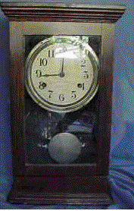
Timer
Eight-bit programmable watchdog timer
  33 MHz, with divisor from 1/32 to 1/4096
Generates an interrupt on zero count
  Initialize it with a negative value
  You can define the function called
  when the clock counts to zero

Slide 34
Using timers
Stop the clock
Set the timer vector
Set the clock rate
Start the clock
Process the callbacks

Slide 35
Stop the clock
void syTmrGenStop(void);

Slide 36
Set the timer vector
void syTmrGenSetInt(void(*)(void *), void *);

Slide 37
Set the clock rate
void syTmrGenSetClock(SY_TMR_CLOCK);
  SY_TMR_CLOCK is currently misleading…

Slide 38
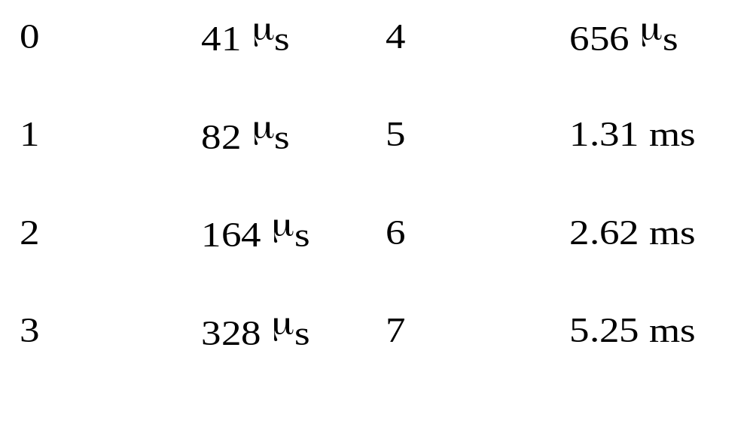
Possible timer intervals

Slide 39
Start the clock
void syTmrGenStart(void);

Slide 40
Process callbacks when they come
void* YourTimerHndlCallback(void *);

